Slide 2
Power API - Intro
The Power API is a comprehensive System software API for interfacing with power measurement and control hardware
Designed to be comprehensive across many different levels of a data center
Many different actors can interfere with a single API to perform several different roles
Encompasses facility level concerns down to low level software/hardware interfaces
Is also suitable for smaller-scale systems, from commercial datacenters to individual desktops
Aims at community driven model.
Specification development and Reference Implementation
The ultimate goal, vendors of the hardware and software components provide their own implementations

Slide 3
Power API Timeline
2013
2014
2015
2016
2017
Use case document prepared by SNL and NREL and reviewed by partners
January 2015
Prototype implementation
release
September 2015
Specification v1.1a
October 2016
Specification v1.4
August 2014
Specification v1.0 release
August 2015
Specification v1.1
May 2016
Specification v1.3
July 2014
Draft specification review meeting with cross-vendor panel of experts
June 2015
Reference Implementation release
February 2016
Specification v1.2
September 2014
meeting with labs, industry, academia

Slide 4














Who is behind Power API

Slide 5
Use cases
Control power in a server hardware with given MW power cap
Accounting and prediction of power load for cooperation with power utilities
Record long term statistical power / energy data for the platform
Users wish to monitor their jobs to understand / improve / energy consumption
Enables studies of whole system power / energy consumption

Slide 6
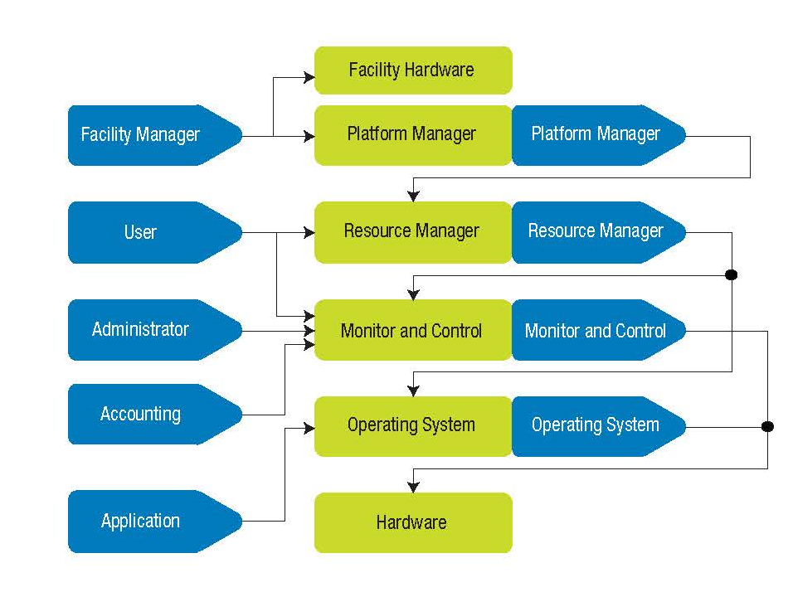
Power API Roles
Platform Manager
Reflects the responsibility of dictating overall system-level policies, such as scheduling priorities and facility limitations
User role
Provides all the capabilities potentially exposed to end users like measurement and controlling.
Application role
Interface for user applications. It is similar to the User role, But with the ability to describe lower-level requirements.
Administrator role
Represents the traditional IT system administrator function, managing day-to-day system operation, but from a power and energy perspective
Accounting role
Interface for generating reports and system metrics at different levels of granularity, from system to individual component
Resource Manager role
Is oriented toward resource managers and job schedulers
Notes:
This is a sample Content with Caption slide ideal for showcasing revenue data, product or market information along with a brief caption or statement.
To Customize and Edit this Chart, follow the steps below (this applies to all slides in this template that contain charts):
To Change Font Color/Size: Select text and adjust the font setting in the Font group in the Home tab. Select desired attributes to change: font, size, boldness, color, etc. Note: many of the same commands can also be accessed from the Mini toolbar.
Edit Chart: Click the chart to edit, right-click and select Edit Data… to access the underlying Excel spreadsheet.
Copying Data From a Separate Excel Spreadsheet: From an existing Excel spreadsheet, select the range of cells to be copied, select copy. In PowerPoint, click the chart, right-click and select Edit Data… to open the spreadsheet for editing. Select all the data in the Chart in Microsoft Office PowerPoint spreadsheet by clicking the top left corner cell, right-click and select Delete. Click in the first empty cell of the spreadsheet and paste (Ctrl V ) to place the data copied from the other Excel file.
Changing Orientation and/or Scale of Data: If no chart elements appear in your chart it is because either 1) the default orientation for pre-made template charts displays data series in rows, not columns, or 2) the axis scale may have to be adjusted (see below).
Change Orientation: Click the chart to edit and select the Chart Tools Design tab (or double-click on the chart). Click the Switch Row/Column button. If the Switch Row/Column button is disabled, click the Select Data button and then click the Switch Row/Column button from within the Select Data Source dialog box, click OK.
Change Scale: Right-click the labels next to the chart’s vertical (value) axis, select Format Axis from the pop-up menu. With Axis Options selected on the left, check all boxes under Auto to automatically provide the appropriate scale based on the data. To provide your own values, select the Fixed option, then type new values in the boxes provided to the right. Click Close when done.

Slide 7
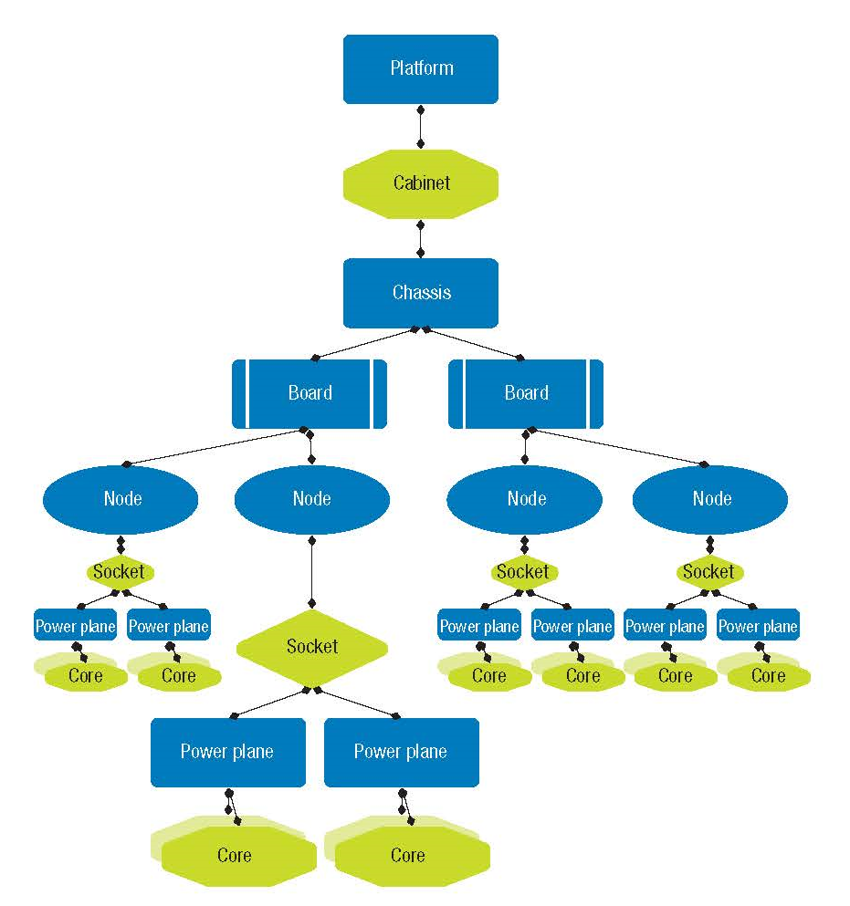
Power API System Description
Platform
At top level and only one can exists
Cabinet
Racks or other logical grouping of nodes. Cabinet level power measurements can be possible with hardware support
Board
Piece of hardware containing multiple nodes
Node
A piece of hardware that contain one or several sockets or core
Socket
A physical socket that can support one or more computational core
Core
A computational core
Notes:
This is a sample Content with Caption slide ideal for showcasing revenue data, product or market information along with a brief caption or statement.
To Customize and Edit this Chart, follow the steps below (this applies to all slides in this template that contain charts):
To Change Font Color/Size: Select text and adjust the font setting in the Font group in the Home tab. Select desired attributes to change: font, size, boldness, color, etc. Note: many of the same commands can also be accessed from the Mini toolbar.
Edit Chart: Click the chart to edit, right-click and select Edit Data… to access the underlying Excel spreadsheet.
Copying Data From a Separate Excel Spreadsheet: From an existing Excel spreadsheet, select the range of cells to be copied, select copy. In PowerPoint, click the chart, right-click and select Edit Data… to open the spreadsheet for editing. Select all the data in the Chart in Microsoft Office PowerPoint spreadsheet by clicking the top left corner cell, right-click and select Delete. Click in the first empty cell of the spreadsheet and paste (Ctrl V ) to place the data copied from the other Excel file.
Changing Orientation and/or Scale of Data: If no chart elements appear in your chart it is because either 1) the default orientation for pre-made template charts displays data series in rows, not columns, or 2) the axis scale may have to be adjusted (see below).
Change Orientation: Click the chart to edit and select the Chart Tools Design tab (or double-click on the chart). Click the Switch Row/Column button. If the Switch Row/Column button is disabled, click the Select Data button and then click the Switch Row/Column button from within the Select Data Source dialog box, click OK.
Change Scale: Right-click the labels next to the chart’s vertical (value) axis, select Format Axis from the pop-up menu. With Axis Options selected on the left, check all boxes under Auto to automatically provide the appropriate scale based on the data. To provide your own values, select the Fixed option, then type new values in the boxes provided to the right. Click Close when done.

Slide 8
Short description of APIs based on Roles from Guide

Slide 9
Power API System Description
Subtitle is Arial 24 pt.
Heading is Arial 24 pt.
First level bulleted text is Arial 18 pt.
Second level text (press tab key) is 16 pt.
Arial is the only font used in this template
All bulleted text is sentence case (capitalize first letter of first word)
Use bold or italics to highlight text

Slide 10
Redfish Resource Map
/redfish/v1
Root resource Links to all content
/redfish/v1/Systems
/redfish/v1/Systems/<id>
Collection of systems
Server information
Model no, serial no, Boot order, NIC MAC, status etc
Processors
/redfish/v1/Chassis
Disks
Collection of chassis
/redfish/v1/Chassis/<id>
NICs
Chassis Chassis global physical asset info
Power
Thermal

Slide 11
Power API Reference Implementation
Power API
Core Features
System Description
XML config
Device Plugins
Daemon
XML RPC
Device Plugins
Powerinsight
Redfish
XTPM
WattsUp
RAPL
PowerGadget

Slide 12
Agent / Listener
Config Manager
Rest Library
Session Manager
Utility
ilo_chassis_power
Ilo_cpu_temp
Ilo_dimm_temp
Ilo_power_cap

Slide 14
Available Solutions and Their Problems
Current Solutions in Market
The Lightweight Distributed Metric Service (LDMS) – collects and aggregates data for variety of hardware
MRNet - collection aggregation over a virtual network
Oscar – compiler and runtime commands
PowerPack toolkit - APIs to enable power measurement on ACPI
Global Energy Optimization Framework (GEO) - manages job power bounds in a cluster and tuning the power consumption
Limitations
Widely varying capabilities and interfaces
Development of supporting tools are costly and inefficient
Lack of single standard API for controlling power and collecting power measurements
Lack of Standard Design hindering customization and new feature support

